Slide 1
Overview of single top physics in CMS with Run-1 data
Rebeca Gonzalez Suarez
University of Nebraska, Lincoln
19th of June 2015
University of Göttingen, II. Physikalisches Institut

Slide 2
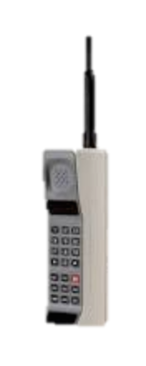

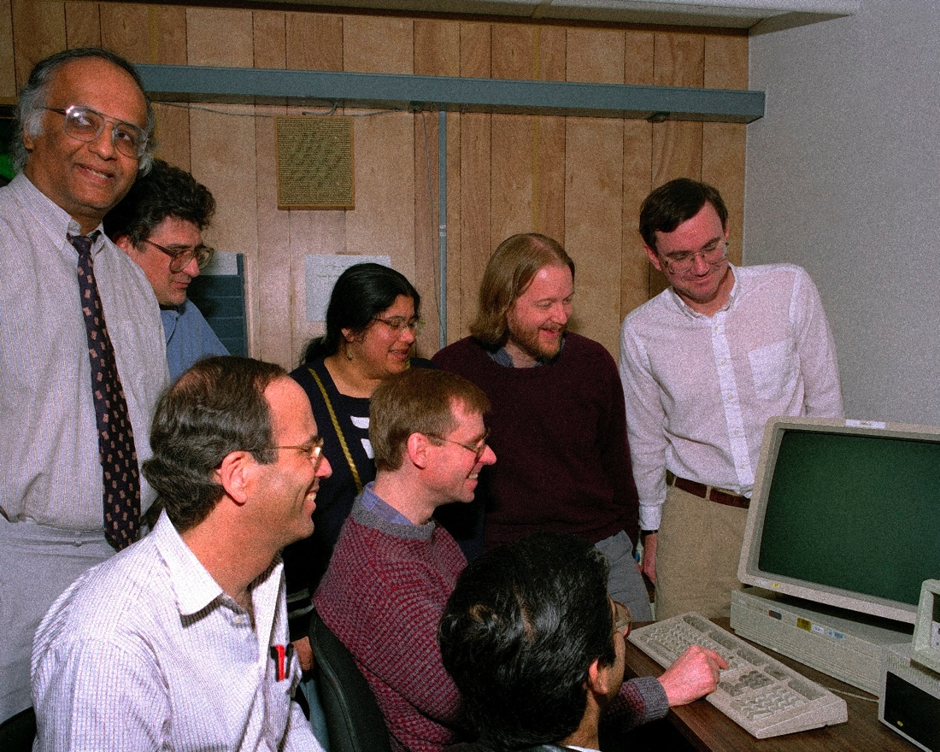
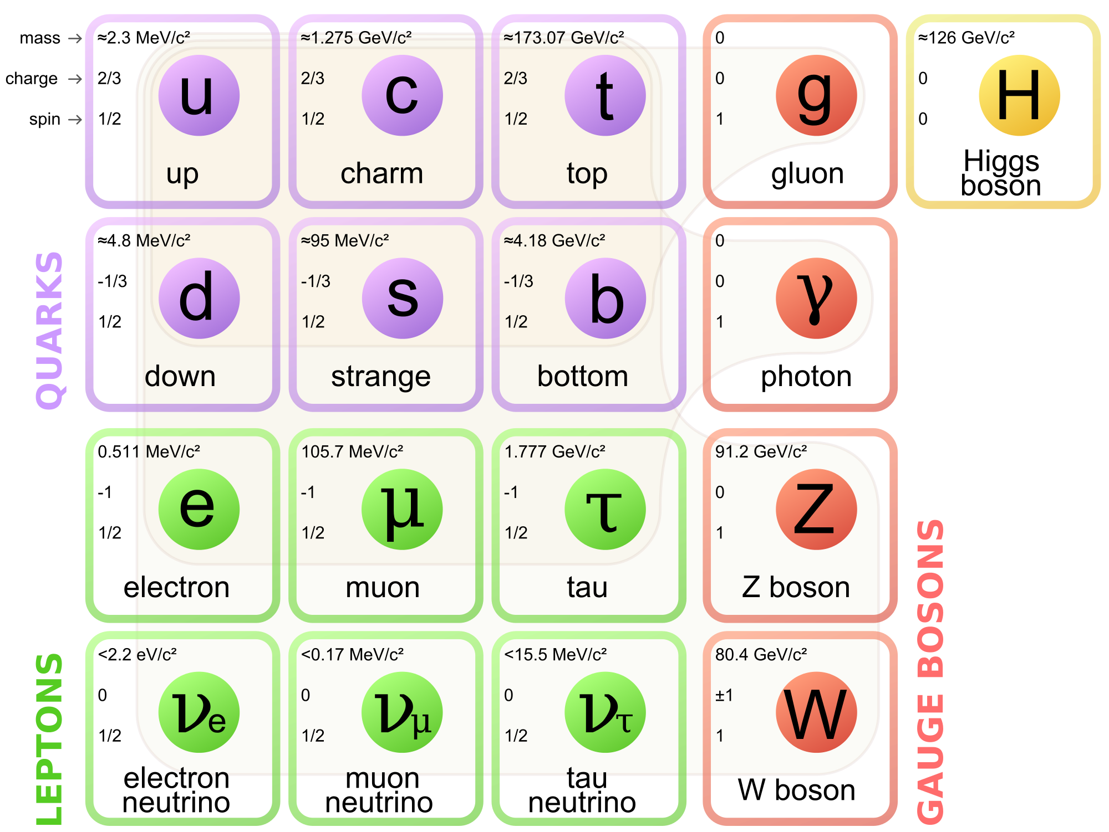
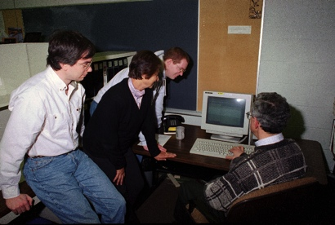
Feb. 24, 1995
20 years ago, the two Tevatron collaborations, CDF and DZero, submitted their Top Discovery papers to PRL:
PRL 74, 2626–2631, PRL 74, 2632–2637
Exactly 6 months before Windows 95 was released the quark family picture was completed
And I was 13 years old…

Slide 3

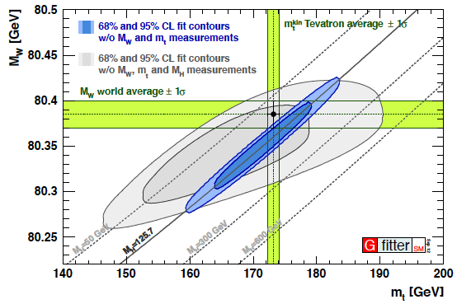
The top quark
Today, we are getting to know the top quark really well → Tevatron legacy of central importance
It is the heaviest elementary particle known
m_{top} = 173.34±0.27(stat)±0.71(syst) GeV
Short lived → only quark that decays before hadronizing
direct access to properties (spin, charge, polarization…)
Has a strong coupling to the Higgs boson
It is a good candidate to play a role in many scenarios of physics beyond the SM (BSM)
Characteristic experimental signature:
Decays almost exclusively as t→ Wb
arXiv:1403.4427

Slide 4
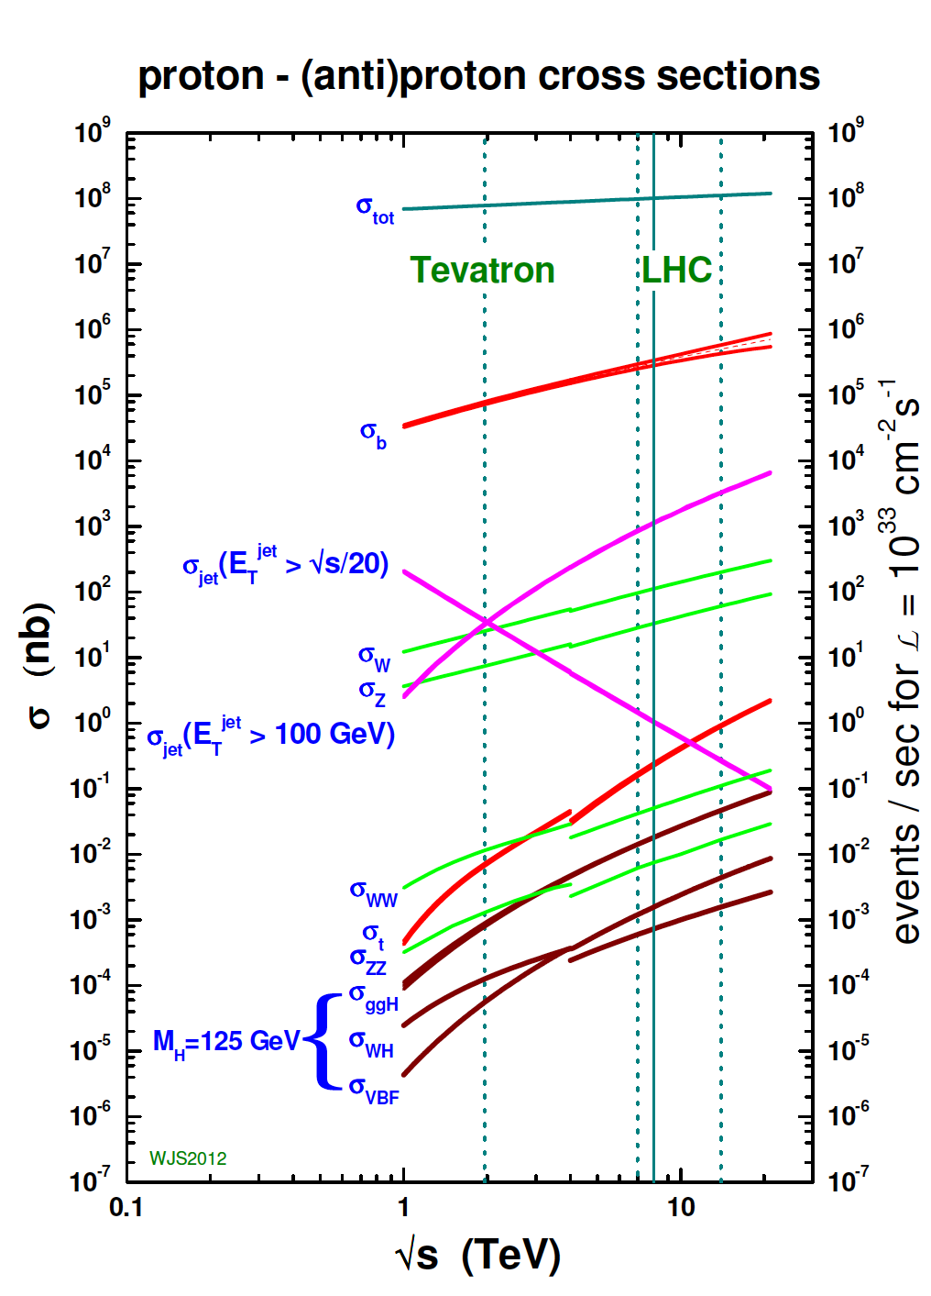
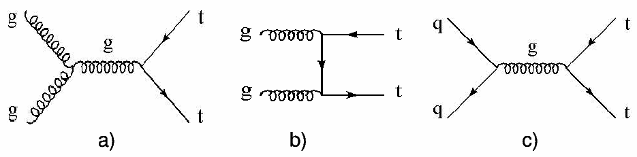

Top quarks at the LHC
At the LHC, top quarks are produced at a very high rate
Main mode: ttbar pairs, via strong interaction
x-sec (pb) | ttbar
Tevatron (1.96TeV) | 7.08 approx. NNLO
LHC @ 7TeV | 177.31 NNLO+NNLL
LHC @ 8TeV | 252.89 NNLO+NNLL
LHC @ 13TeV | 831.76 NNLO+NNLL
t
t
t
t
“The LHC is a top quark factory!”

Slide 5
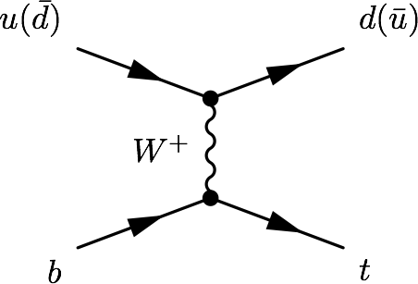
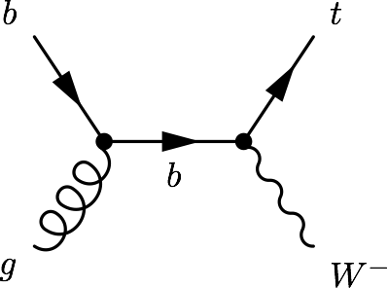
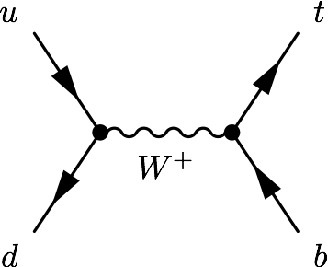
Single top production
There is an alternative mode, at a lower rate: Single top quark production
Via electroweak interaction, involving a Wtb vertex
Three main process: t-channel, tW associated production, s-channel
σ [pb] | t-channel | tW | s-channel
Tevatron (1.96TeV) | 2.08 | 0.22 | 1.046
LHC @ 7TeV | 63.89 | 15.74 | 4.29
LHC @ 8TeV | 84.69 | 22.2 | 5.24
LHC @ 13TeV | 216.99 | 71.2 | 10.32

Slide 6
Single top timeline
1986
Tevatron starts colliding
Single top quarks were also observed for the first time at the Tevatron, in March 2009
ATLAS and CMS presented their first t-channel studies with 7TeV data early 2011
Since then, all the main modes have been studied, the t-channel has been used to measure SM properties, and several single top related signatures have been used to study new physics
PRL103:092002, PRL.103:092001
1995
Top quark discovery
CMS-PAS-TOP-11-021, ATLAS-CONF-2011-088
2009
Single top discovery
“The LHC is a SINGLE top quark factory!”
2010
LHC starts colliding
2011
First single top results at the LHC

Slide 7
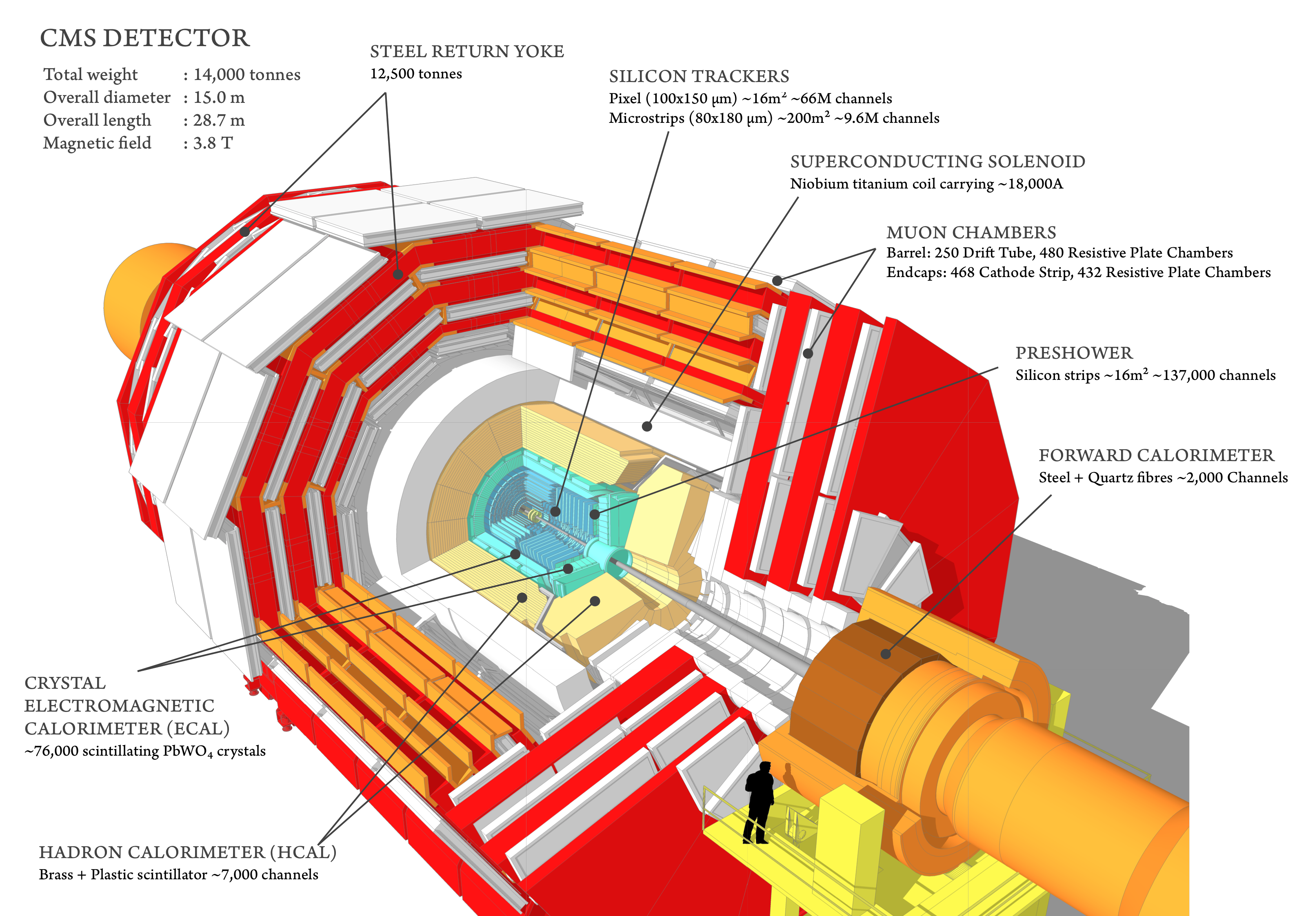
Compact Muon Solenoid (CMS)
Compact Muon Solenoid (CMS)
Total weight : 14,000 tonnes
Overall diameter : 15,0 m
Overall length : 28,7 m
Magnetic Field : 3.8 T
More than 2,600 people
41 countries

Slide 8
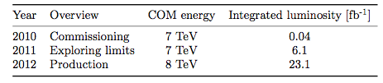
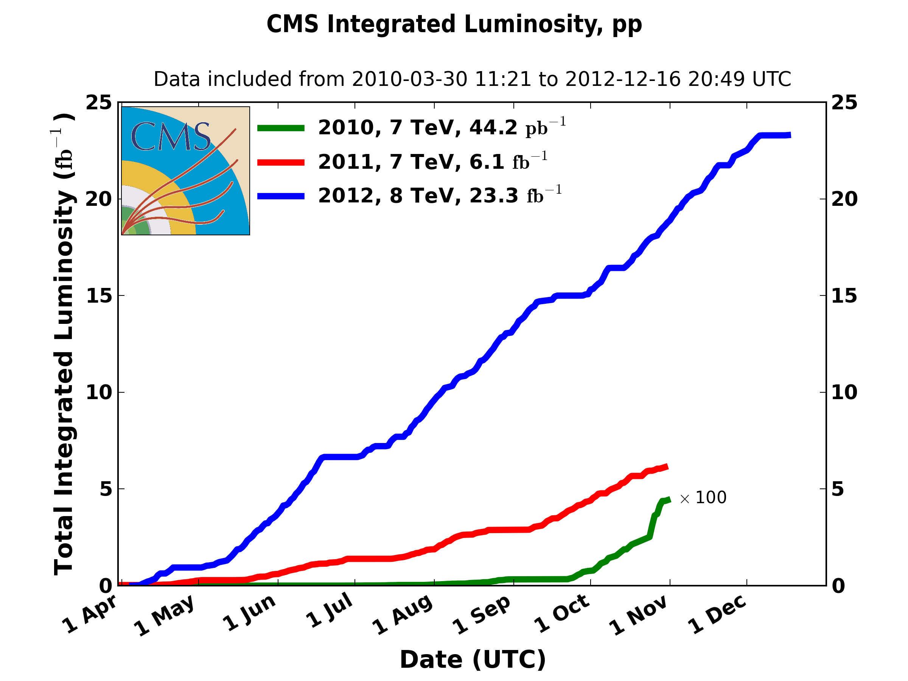
Run-1 in tops
The Run-1 of the LHC started in March 2010 and ended in February 2013
During three years: ~5fb⁻¹ of pp collisions at 7TeV and ~20fb⁻¹ at 8TeV
This means that CMS has recorded:
More than 5M ttbar pairs
Around 2M of single top quarks (via t-channel)
And also:
Half a million of tW events and a bit more than 100K of s-channel events
What have we done with them?

Slide 9
Step 1
Study the three single top production modes and measure their production cross section

Slide 10
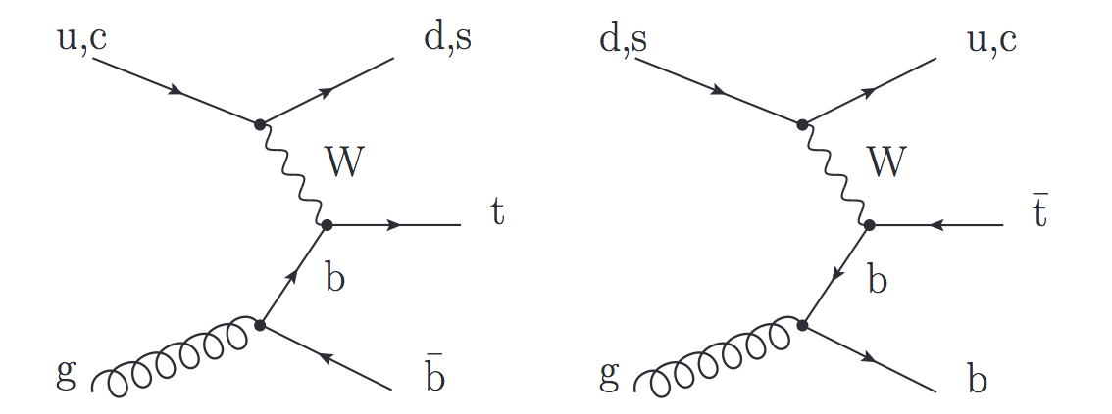
t-channel
Dominant process with the highest cross section at the Tevatron and the LHC
Final state studied: lepton + jets signature
Signal events characterized by:
One isolated muon or electron
Missing transverse energy (MET)
A central b jet
light-quark jet from the hard scattering process (often forward)
Additionally, a second b jet produced in association to the top quark
Main backgrounds: W+jets, ttbar, multijet
Leptonic top decay

Slide 11
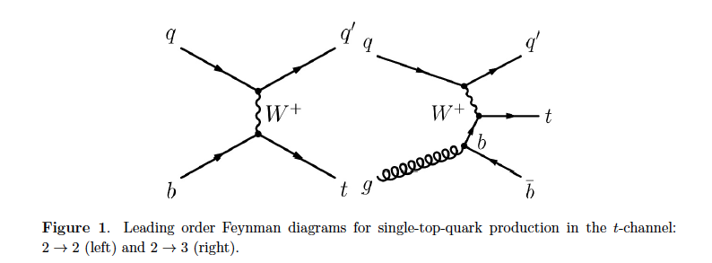
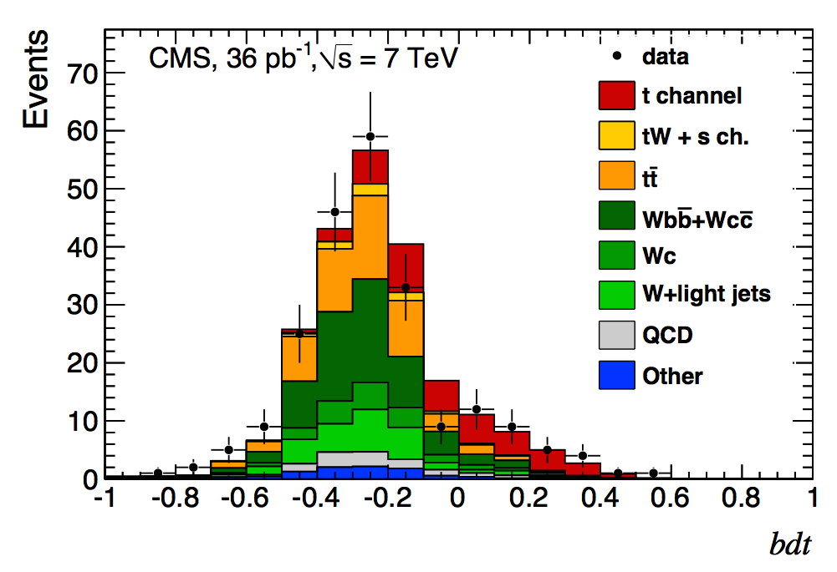
t-channel
Before the start of the Run-1
only t-channel production had been observed at the Tevatron
In 2011, barely a year into collisions, CMS published its first t-channel paper
Jun 2011
Phys. Rev. Lett. 107:091802,2011
arXiv:1106.3052
36pb⁻¹
In one year, power to explore processes that had taken decades before

Slide 12
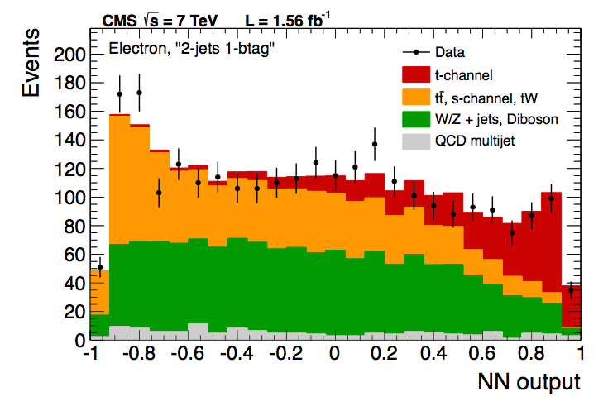
t-channel (7TeV)
At 7 TeV CMS measured the inclusive t-channel cross section
Using Multivariate methods (BDT, NN) and the shape of the pseudorapidity of the light jet, |η_{j’}|
Different regions defined (jets, b-tag)
Multijet and W+jets background estimated from data
Statistical, systematic, and theory uncertainties on the same level
September 2012
JHEP 12 (2012) 035, arXiv:1209.4533
7TeV - 1.17 and 1.56 fb⁻¹

Slide 13
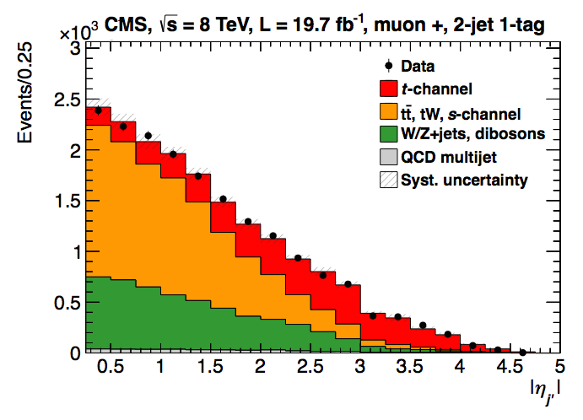
t-channel (8TeV)
At 8 TeV, the measurement was done using the |η_{j’}| analysis alone
Similar approach as for 7TeV, more data-driven (Multijet, W+jets, ttbar)
Full luminosity
Systematic dominated
main uncertainties:
Signal modeling (~6%)
and JES/JER/MET (~4%)
March 2014
JHEP 06 (2014) 090, arXiv:1403.7366
8 TeV - 19.7fb⁻¹

Slide 14
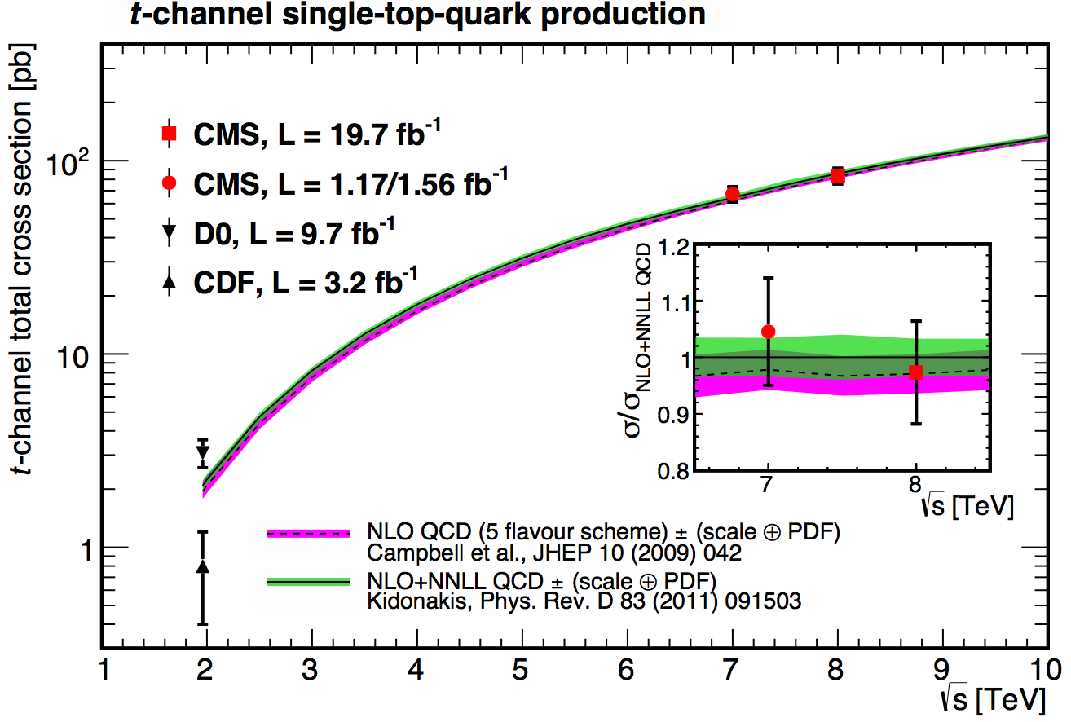
t-channel: results
7TeV | Measured | 67.2±3.7(stat)±3.0(syst)±3.5(th)±1.5(lumi) pb = 67.2±6.1 pb
 | Prediction | 63.89+2.91-2.52 (NLO, latest calculation)
8TeV | Measured | 83.6±2.3 (stat) ±7.4 (syst) pb
 | Prediction | 84.69+3.76 -3.23 (NLO, latest calculation)

Slide 15
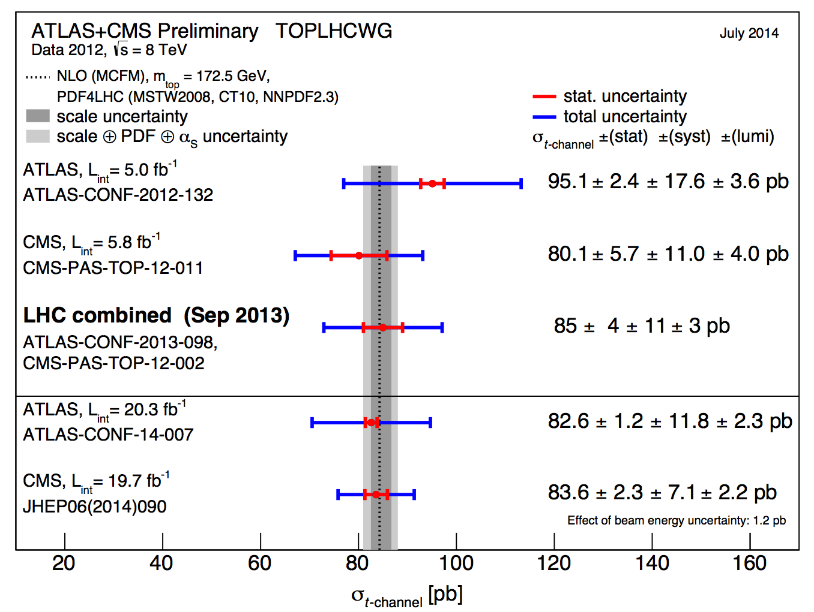
t-channel: LHC combination
At 8TeV, an LHC (ATLAS+CMS) combination was made
It was the first LHC single top combination
Sept. 2013
CMS-PAS-TOP-12-002

Slide 16
tW associated production
Single top process with the second largest cross-section at the LHC
Final state studied: dilepton signature
Signal events are characterized by:
Two opposite-sign, isolated leptons
Missing transverse energy (2 neutrinos in the final state)
A jet coming from a b decay
Backgrounds: ttbar (main challenge), DY

Slide 17
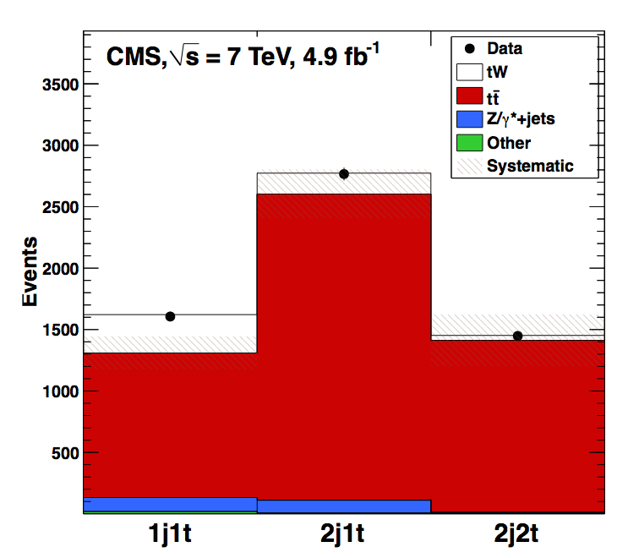
tW associated production
The low cross section of this process at the Tevatron made it impossible to study before the LHC → At the LHC is still not easy
CMS reported Evidence at 7TeV
September 2012
Phys. Rev. Lett. 110 (2013) 022003
arXiv:1209.3489
4.0σ
7TeV - 4.9fb⁻¹

Slide 18
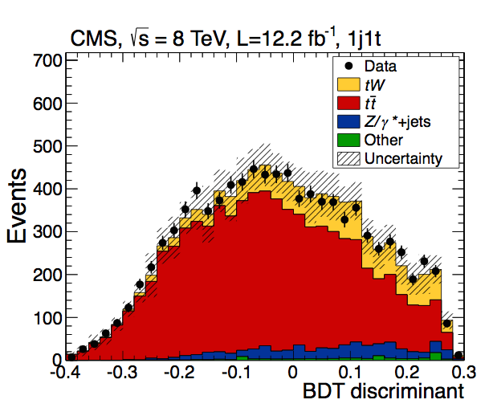
tW associated production
And discovery at 8TeV → Achieving observation (> 5 σ)
January 2014
Phys. Rev. Lett. 112 (2014) 231802
arXiv:1401.2942
6.1σ
8TeV - 12.2fb⁻¹
7 TeV → cut-based, basic BDT
8TeV → cut-based, shape-based, more sophisticated BDT
At 8TeV the analysis is already not statistically limited

Slide 19
tW associated production
The main challenge is the ttbar background
ttbar with 1 jet outside acceptance or miss-reconstructed → main background
→ Very similar final states and their diagrams mix at NLO
→ Main uncertainties come from theory modeling of ttbar
2 control regions were established
7TeV | Measured | σ_{tW} =16+5-4 pb
 | Prediction | σ_{tW} = 15.6±0.4±1.1 pb
8TeV | Measured | σ_{tW} = 23.4±5.4 pb
 | Prediction | σ_{tW} = 22.2±0.6±1.4 pb

Slide 20
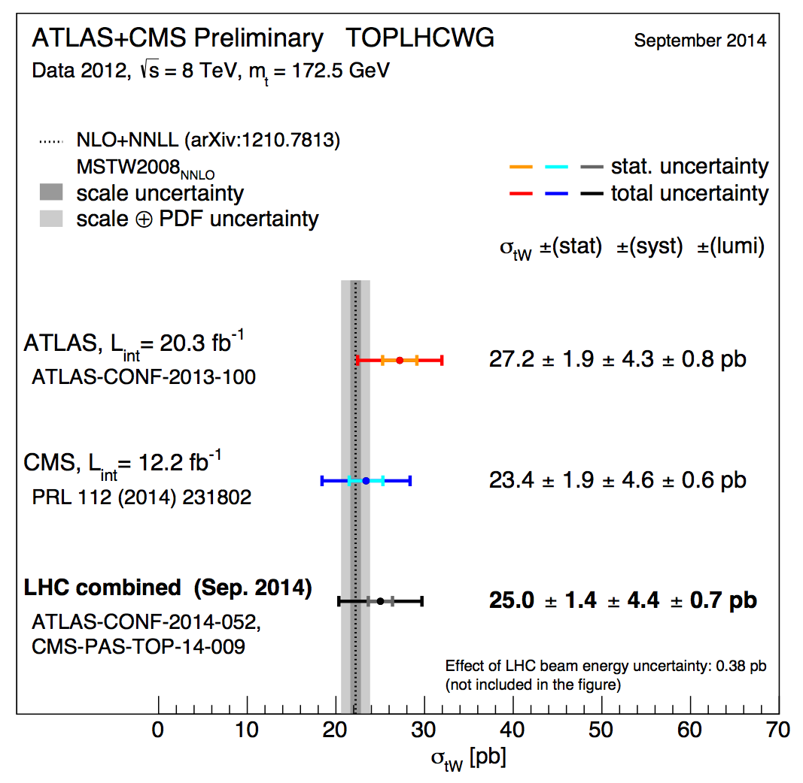
tW Combination with ATLAS
Recently, an ATLAS+CMS tW combination at 8TeV was also made public
September 2014
PAS TOP-14-009

Slide 21
s-channel
Lowest cross-section at the LHC, more important at the Tevatron (where the study of data after the shutdown allowed for the observation of the process)
Production mode sensitive to new physics: W’ bosons, charged Higgs bosons
Very challenging final state: low cross-section, difficult to separate from backgrounds
Signal signature: lepton + jets
A lepton (e,µ) and MET from the decay of a W boson
Two jets with high transverse momentum originating from b-quarks
Main backgrounds: W+jets and ttbar, multijet
Phys. Rev. Lett. 112, 231803 (2014)

Slide 22
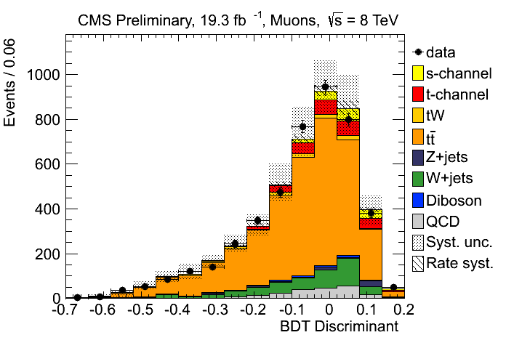
s-channel
CMS has a preliminary result at 8TeV
CMS-PAS-TOP-13-009
(November 2013)
Full lumi, e and µ
BDT
S/B is a bit better at 7TeV
In Run-2 will be even harder
σ [pb] | t-channel | tW | s-channel
LHC (7 TeV) | 63.89 | 15.74 | 4.29
LHC (8 TeV) | 84.69 | 22.2 | 5.24
LHC (13TeV) | 216.99 | 71.2 | 10.32
σ_{s-channel} = 6.2±5.4(exp.)±5.9(th)pb = 6.2+8.0-5.1 pb (FC)
σ^{th}_{s-channel} = 5.55 ± 0.08 (scale) ± 0.21(PDF) pb (NNLL)
Upper limit of 2.1 (3.1,1.6) times the SM

Slide 23
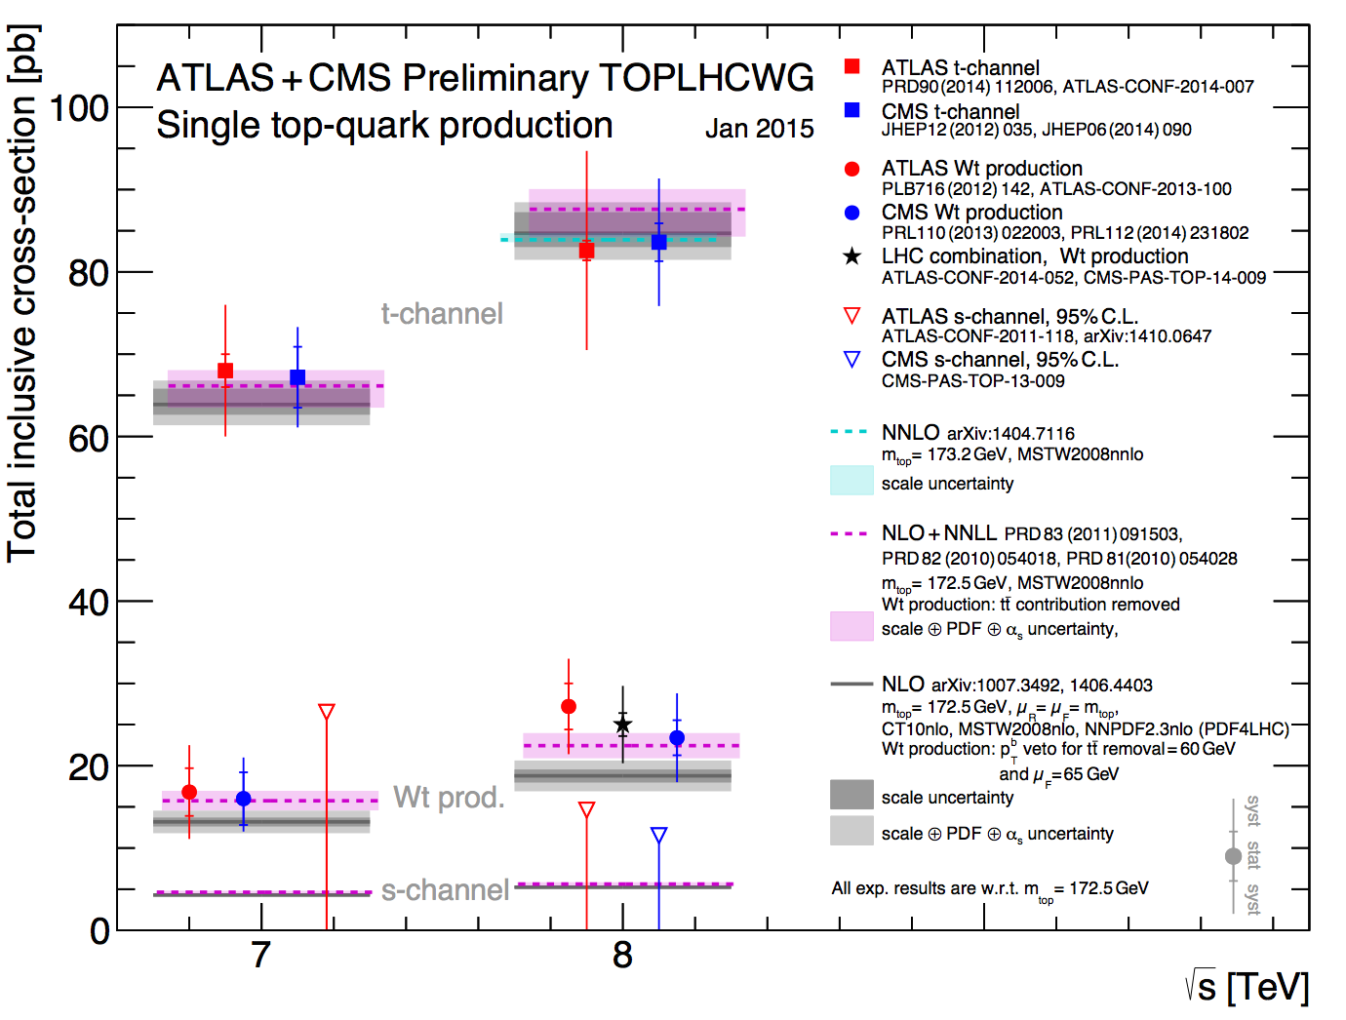
Run-1 Summary

Slide 24
Step 2
Measure SM properties in single top signatures

Slide 25

Measurements
Tevatron + LHC established the three single top modes:
Discovery era is over → Enter the measurements age
During Run-1, Different SM measurements in the top sector performed in ttbar
Competitive measurements since early data taking
The single top production at the LHC is large enough to measure
top properties in single top signatures
Complementary to ttbar
Another handle to tests potential BSM phenomena
Valuable to get the full picture

Slide 26
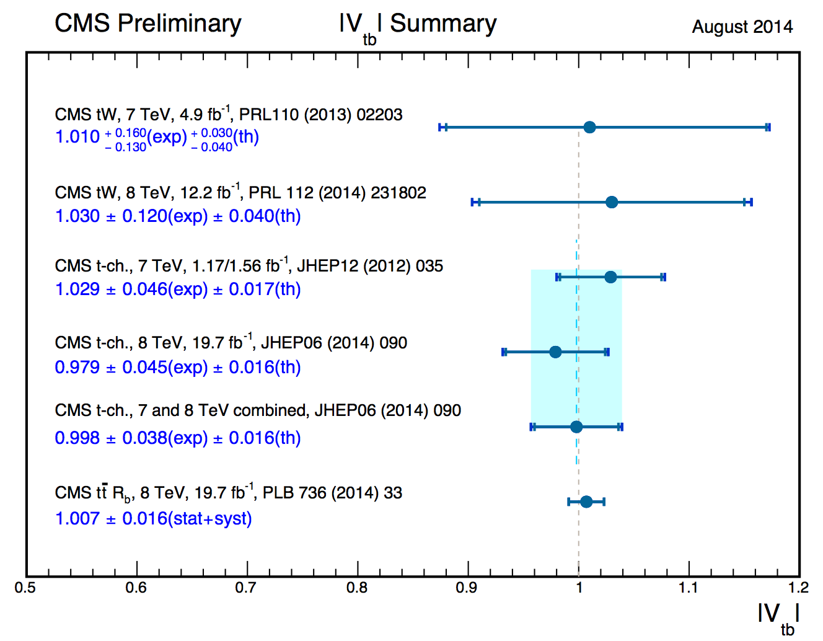
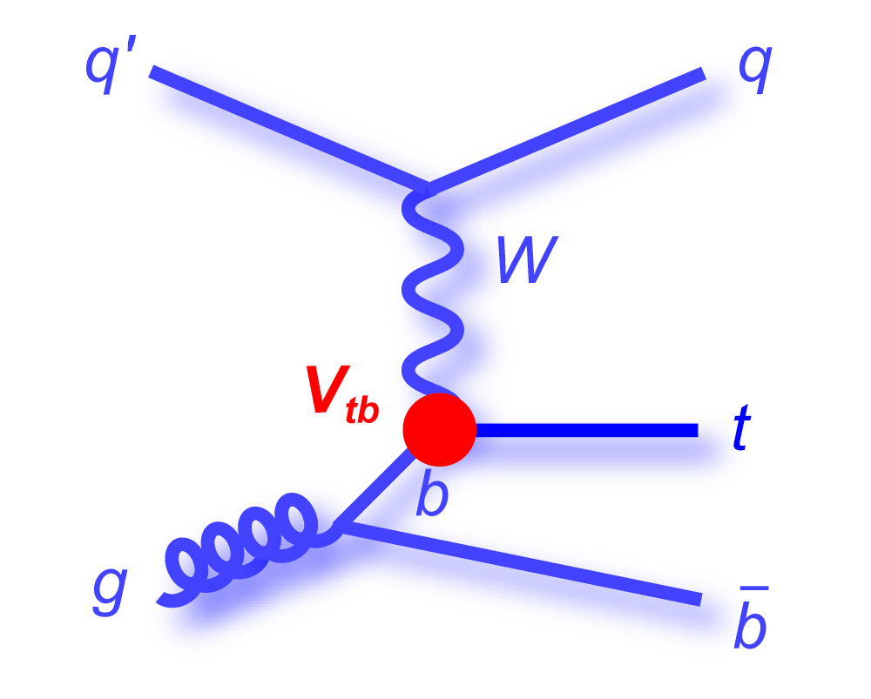
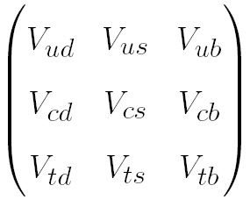
Cross-section and |V_{tb}|
From the inclusive production cross section 0f single top (t-channel, tW), a value of the CKM matrix element, |V_{tb}|, can be extracted
Considering |V_{td}|, |V_{ts}| << |V_{tb}|
Cross section ~ |V_{tb}|²

Slide 27
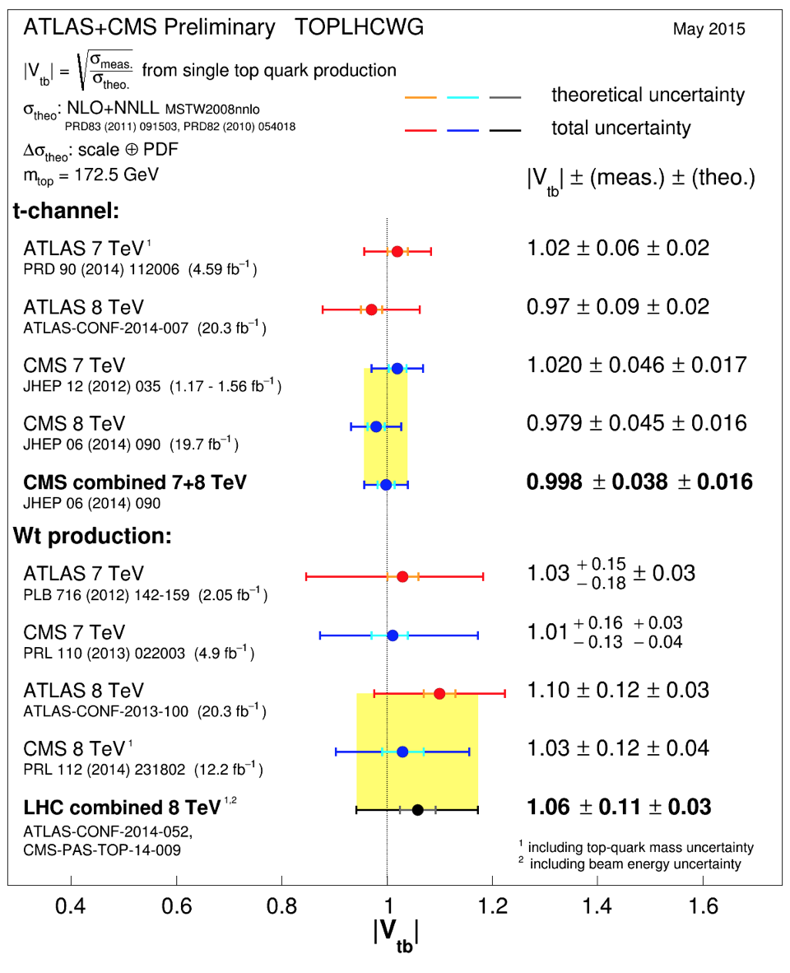
LHC |V_{tb}| combination
TOPLHCWG made this summary plot public last month
May 2015

Slide 28
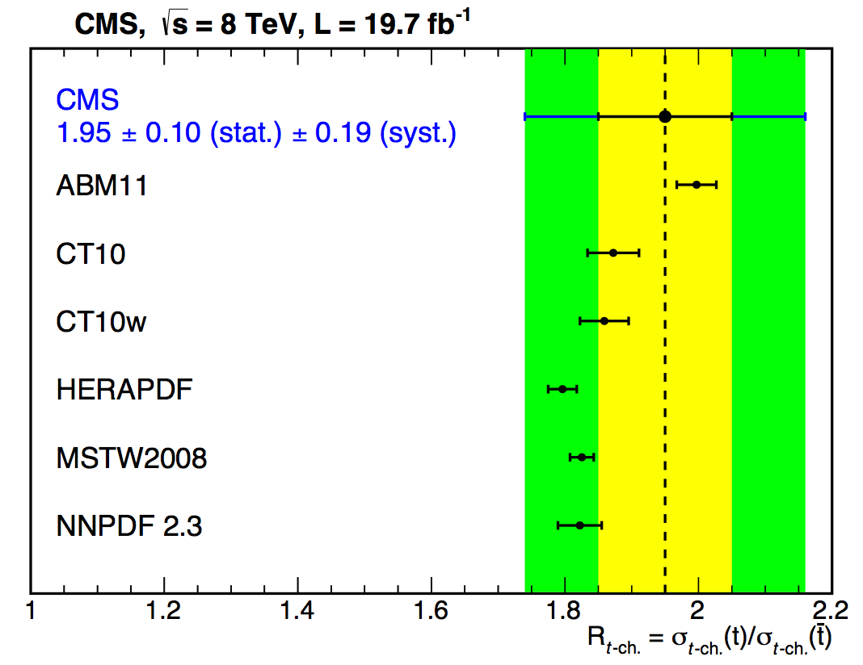
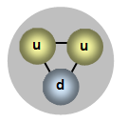
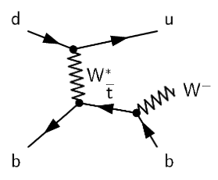
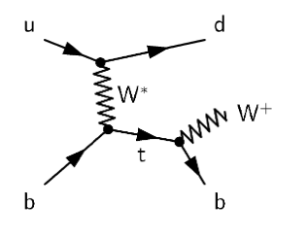
t-channel: R
Within the measurement of the t-channel cross-section at 8TeV, we measure the top/anti-top asymmetry, R
Due to the relative proportion of u and d quarks in the proton, more tops than anti-tops are expected to be produced
σ_{top} = 53.8±1.5(stat.)±4.4(syst)pb | R = 1.95±0.10(stat)±0.19(syst)
σ^{th}_{top} = 54.87 +2.29 -1.94 pb (NLO, latest calculation)
σ_{anti-top} = 27.6±1.3(stat.)±4.4(syst)pb
σ^{th}_{anti-top} = 29.74 +1.67 -1.51 pb (NLO, latest calculation)
JHEP 06 (2014) 090, arXiv:1403.7366

Slide 29
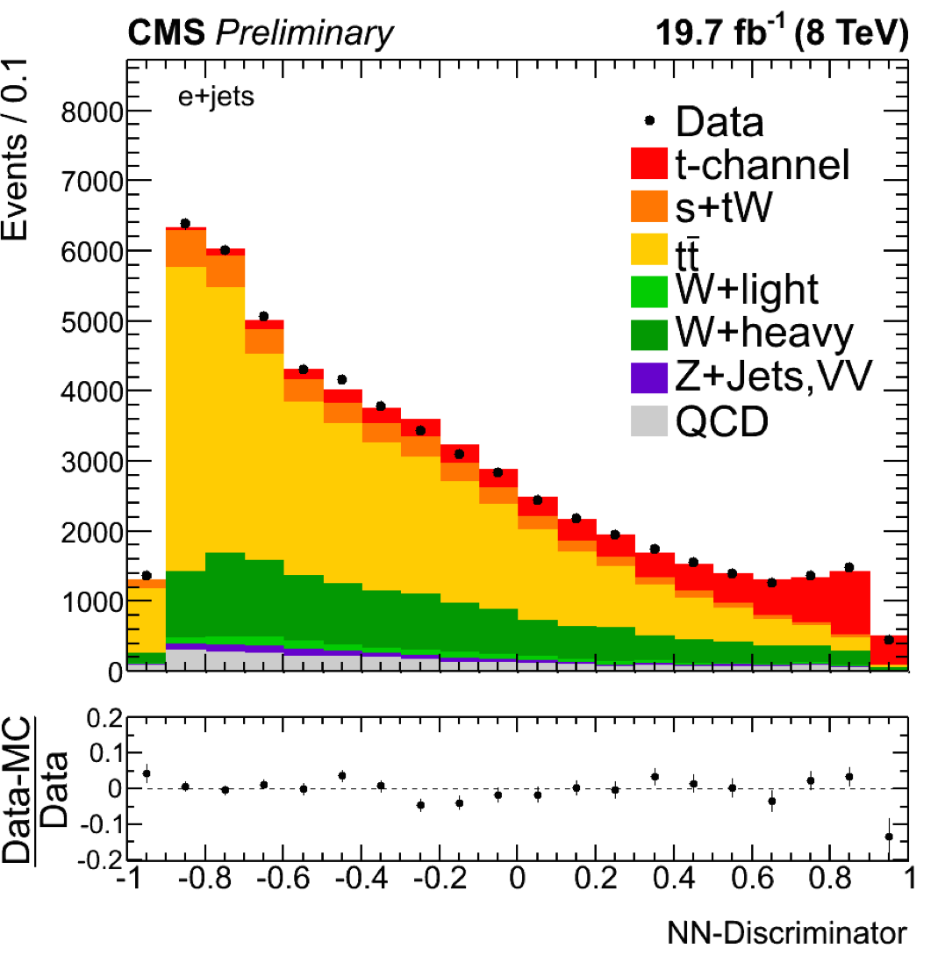
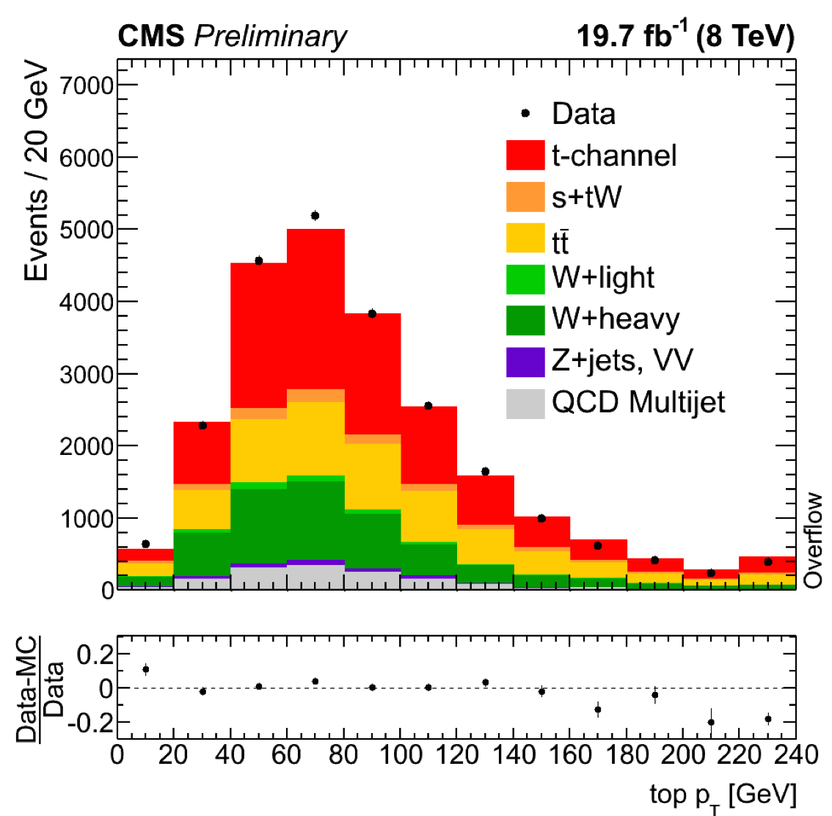
t-channel: differential x-sec
t-channel differential cross section came last September, still preliminary
8 TeV, full luminosity
Starting in the same way as the inclusive cross section, the analysis uses a NN to isolate a purer t-channel sample
September 2014
CMS PAS TOP-14-004
Events are selected by cutting on an optimal NN discriminant value

Slide 30
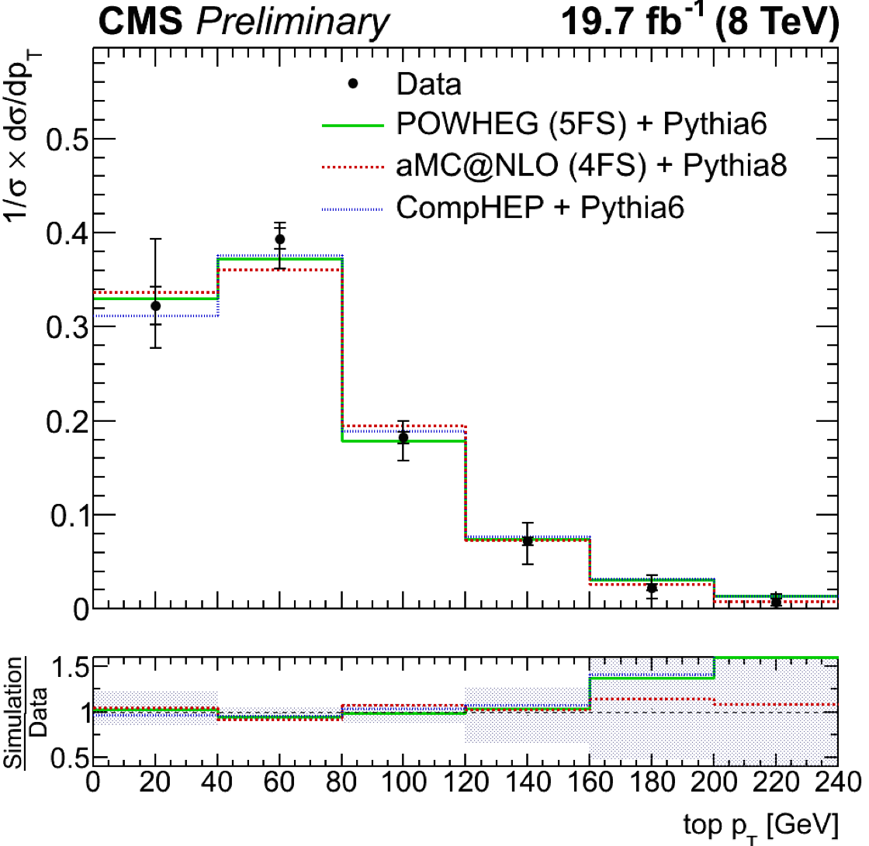
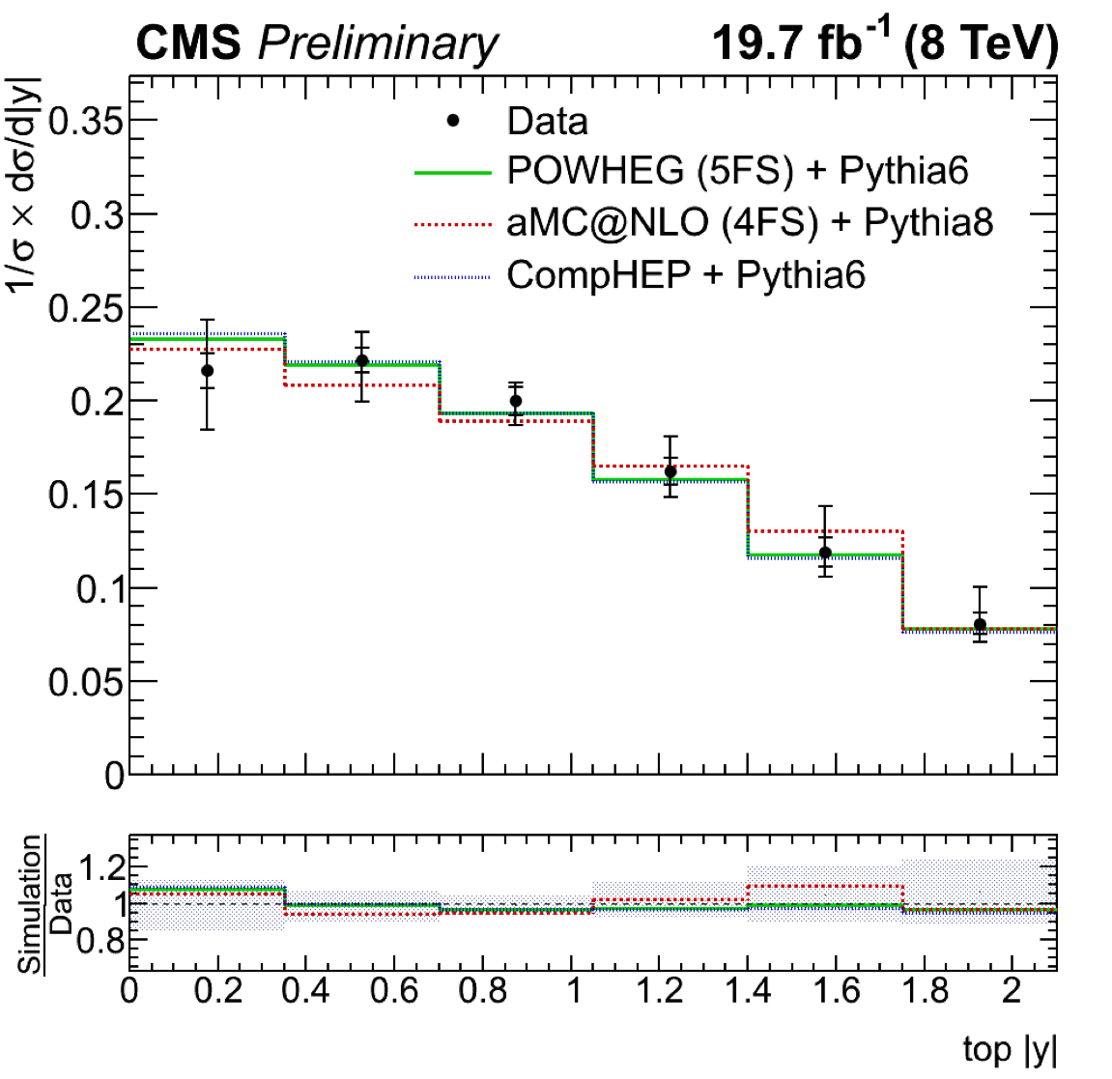
t-channel: differential x-sec
Distributions of the p_{T} and rapidity of the top quarks are then corrected for detector effects (Unfolded) and compared directly with different theoretical predictions:
PowHeg+Pythia (solid), aMC@NLO+Pythia (dotted), and CompHEP (dashed)
CMS PAS TOP-14-004

Slide 31
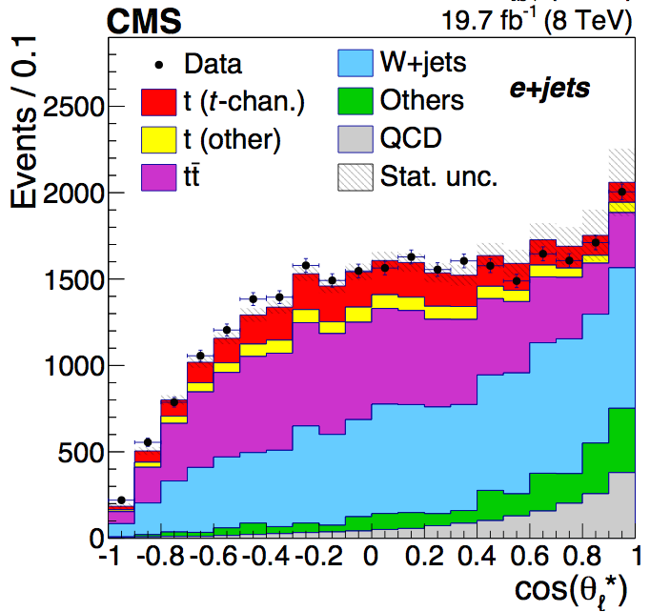
t-channel: W-helicity
Going further than cross section measurements → measurement of the W-helicity fractions
Exact same selection and background estimation as the standard t-channel inclusive cross section measurement
θ*: angle between the W boson in the top rest frame and the lepton in the W rest frame → related to the W-helicity fractions (F₀, F_{L}, F_{R})
October 2014
JHEP 01 (2015) 053, arXiv:1410.1154
W boson helicity in t-channel

Slide 32
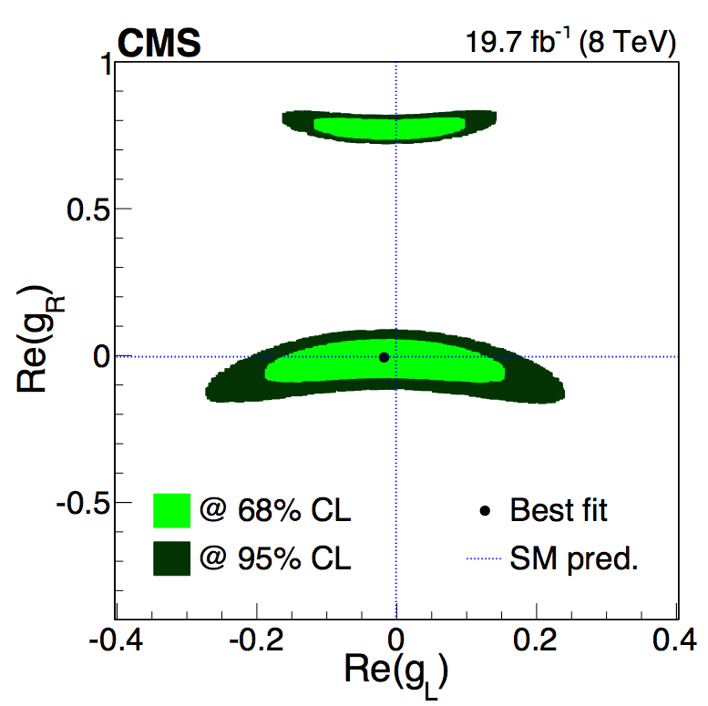
t-channel: W-helicity (II)
Theory prediction (NNLO) | Measured
F_{L} = 0.311 ± 0.005 F_{R} = 0.0017 ± 0.0001 F₀ = 0.687 ± 0.005 PRD 81, 111503(R) (2010) | F_{L} = 0.298 ± 0.028 (stat) ± 0.032 (syst) F_{R} = -0.018 ± 0.019 (stat) ± 0.011 (syst) F₀ = 0.720 ± 0.039 (stat) ± 0.037 (syst)
Using the helicity fractions measured → exclude the tensor terms of the tWb anomalous couplings, g_{L} and g_{R}
October 2014
JHEP 01 (2015) 053, arXiv:1410.1154
W boson helicity in t-channel

Slide 33
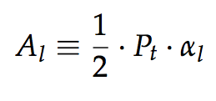
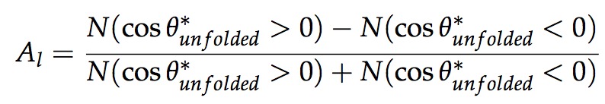
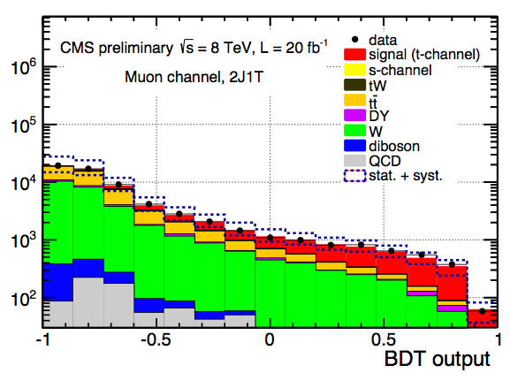
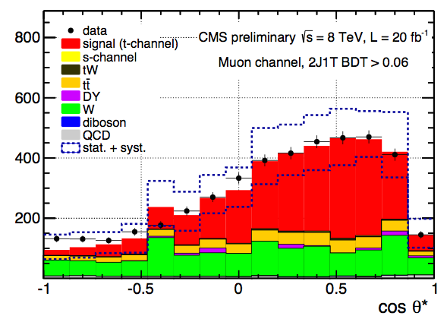
t-channel: top polarization
Single top quarks are highly polarized, spin aligned with the recoiling light jet
The top quark polarization relates to the spin asymmetry
Which can be extracted from the cosθ*_{l} distribution
A BDT is used to get a t-channel enriched sample
August 2013
CMS-PAS-TOP-13-001

Slide 34
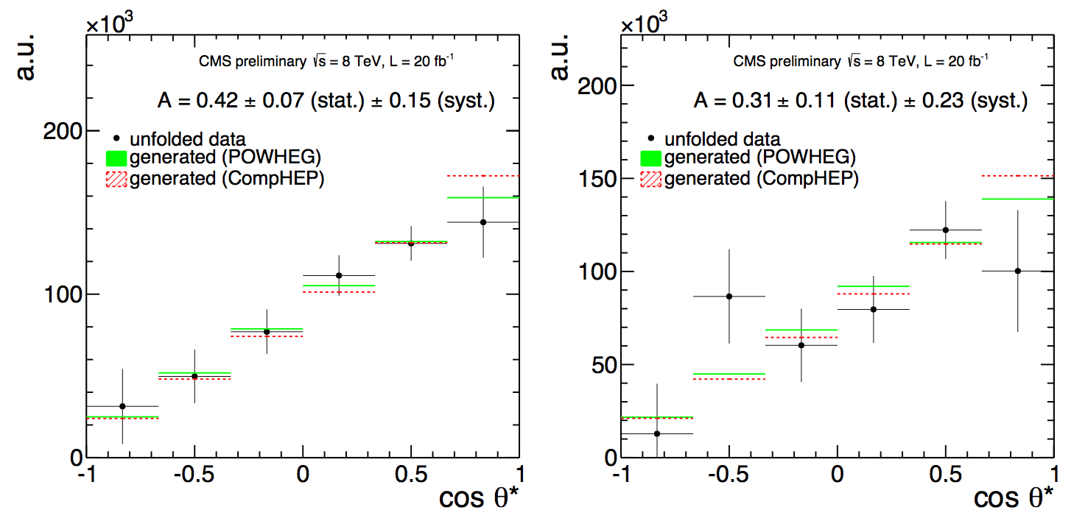
t-channel: top polarization (II)
Asymmetry and polarization are obtained from the unfolded distributions
µ
e
A_{l}=0.41±0.06(stat.)±0.16(syst.) (SM expectation 0.44)
P_{t}=0.82±0.12(stat.)±0.32(syst.)
August 2013
CMS-PAS-TOP-13-001

Slide 35
Step 3
Search for FCNC and Anomalous Couplings

Slide 36
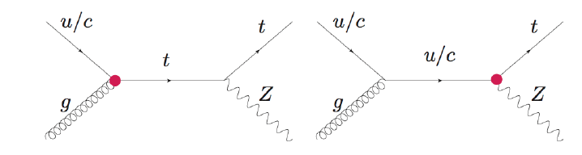
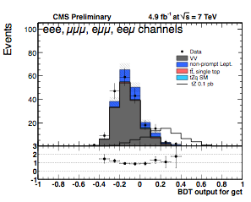
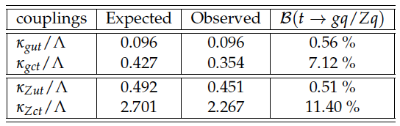
FCNC tZq
Limits on anomalous Wtb couplings can be extracted from SM measurements (W-helicity fractions, top polarization) → Dedicated analysis searching for deviations from the SM are also in place in single top signatures
July 2013
CMS-PAS-TOP-12-021
FCNC tZq
Three-lepton signature, 7TeV
BDT (gut, gct, Zut, Zct)
Simulated samples with different scenarios
No excess → Limits on couplings and branching fractions

Slide 37
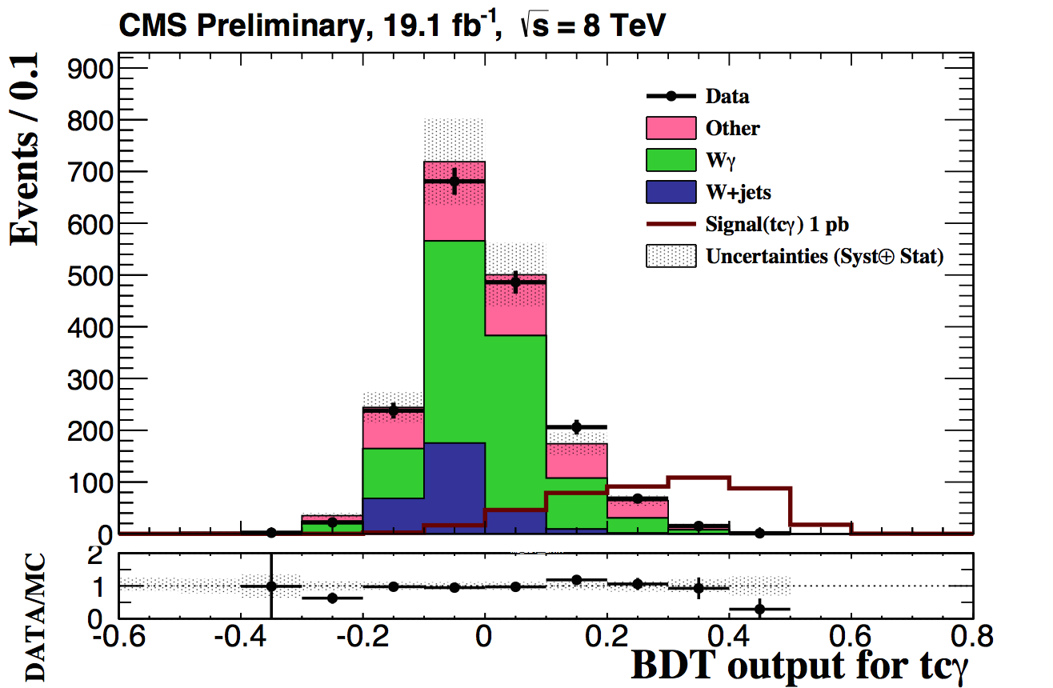
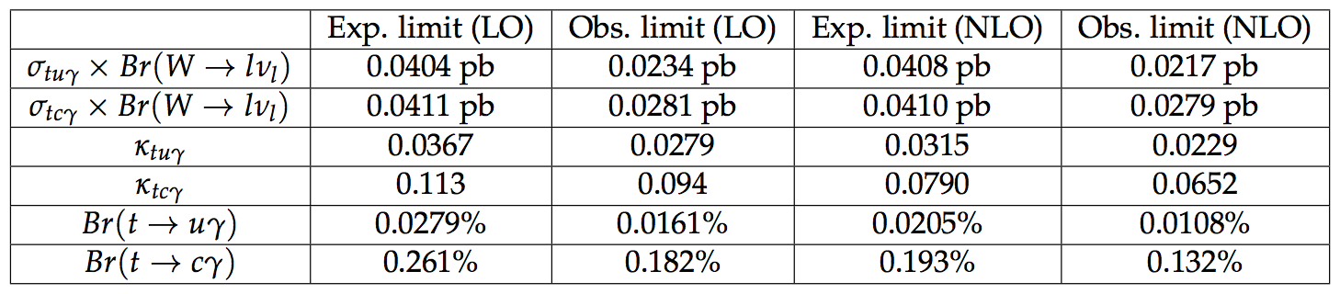
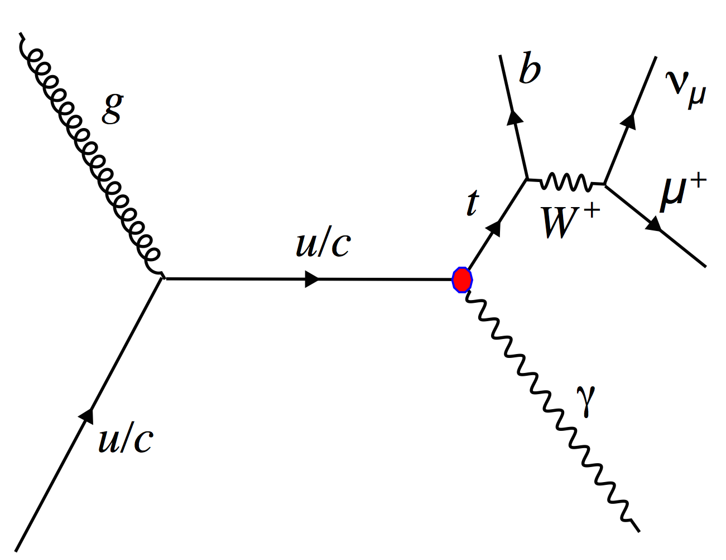
FCNC tγ
Preliminary result from Spring last year
tqγ, single top produced in association with a photon
Enhancement on t→u(c)γ BR due to FCNC
Samples with anomalous tuγ, tcγ couplings
8TeV, µ only
Dedicated BDTs
No excess → Limits on couplings and branching fractions
May 2014
CMS PAS-TOP-14-003

Slide 38

FCNC and AC in t-channel
May 2014
CMS PAS-TOP-14-007
Another preliminary result from Spring last year
FCNC and anomalous couplings in t-channel
Anomalous operators in the Wtb vertex and tcg/tug FCNC couplings
7TeV, µ
NN to separate different scenarios considered Vs SM
No excess → Limits on couplings and branching fractions

Slide 39
Step 4
Explore unusual single top signatures

Slide 40




Top+ Higgs
single top + Higgs (complementary to ttH)
tH production highly suppressed in the SM
If top Higgs Yukawa coupling is negative → enhanced
Several decays investigated, more to come, all preliminary
Need Run-2 to become sensitive
tH, H→WW
CMS PAS-HIG-14-026
(February 2015)
tH, H→γγ
CMS PAS-HIG-14-001
(March 2013)
tH, H→bb
CMS PAS-HIG-14-015
(October 2014)

Slide 41

BSM top + X
There are many other BSM channels that involve top quarks and/or similar signatures to single top:
classic example: W’→tb (arXiv:1402.2176)
Some feature truly “single” top quarks
Monotop
Dark Matter search using top + MET
arXiv:1410.1149
Phys.Rev.Lett. 114 101801(2015)
(October 2014)

Slide 42
Next steps?

Slide 43
Run-2
There are still open topics still to be explored by CMS with Run-1
Top mass in single top signatures, fiducial cross sections...
Run-2 is just starting now! → Will run ~3 years [300fb⁻¹ at 13 (14) TeV]
t-channel: Has become a SM candle (early analysis~1fb⁻¹ )
tW and tt interplay → Run-2 goal
With higher luminosity and center of mass energies
Work on systematics and modeling
Face new challenges (high pileup)
Moving towards “precision” era
Rare SM processes accessible (SM tZq and tγq)
More BSM channels to explore
New approaches: Single top in heavy ions! (?) arXiv:1502.04875

Slide 44
Summary
Single top signatures were very rare and largely unknown until recently
In less than 10 years we have made incredible progress
→ the LHC is very powerful for top, and single top in particular
We have studied the three main production modes
There are so many single top quarks produced via t-channel that we can use them to make measurements:
W-helicity fractions, top polarization, |V_{tb}|…
We have used conventional and rare single top production modes to look for FCNC and Anomalous Couplings
We have started the exploration of more exotic single top processes looking for new phenomena
Run-2 will be the time to fully explore single top signatures, in particular to look for physics beyond the standard model

